Slide 1
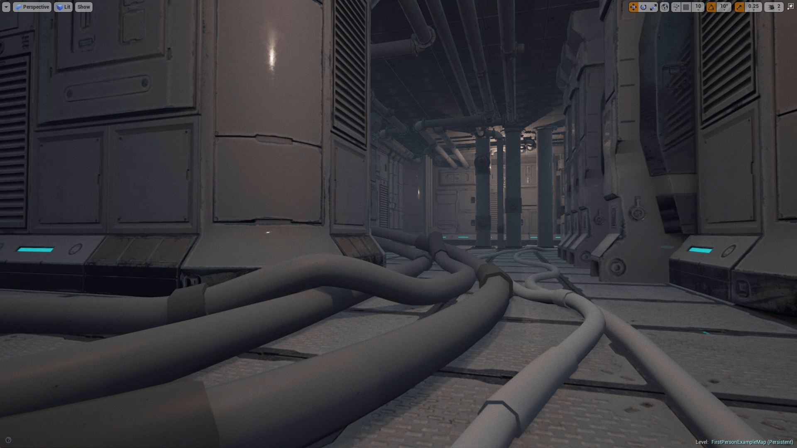
C++ Toronto A Small Talk About Arrays
Mark Elendt | SideFX

Slide 2
C++ Toronto A Talk About Small Arrays
Mark Elendt | SideFX

Slide 3
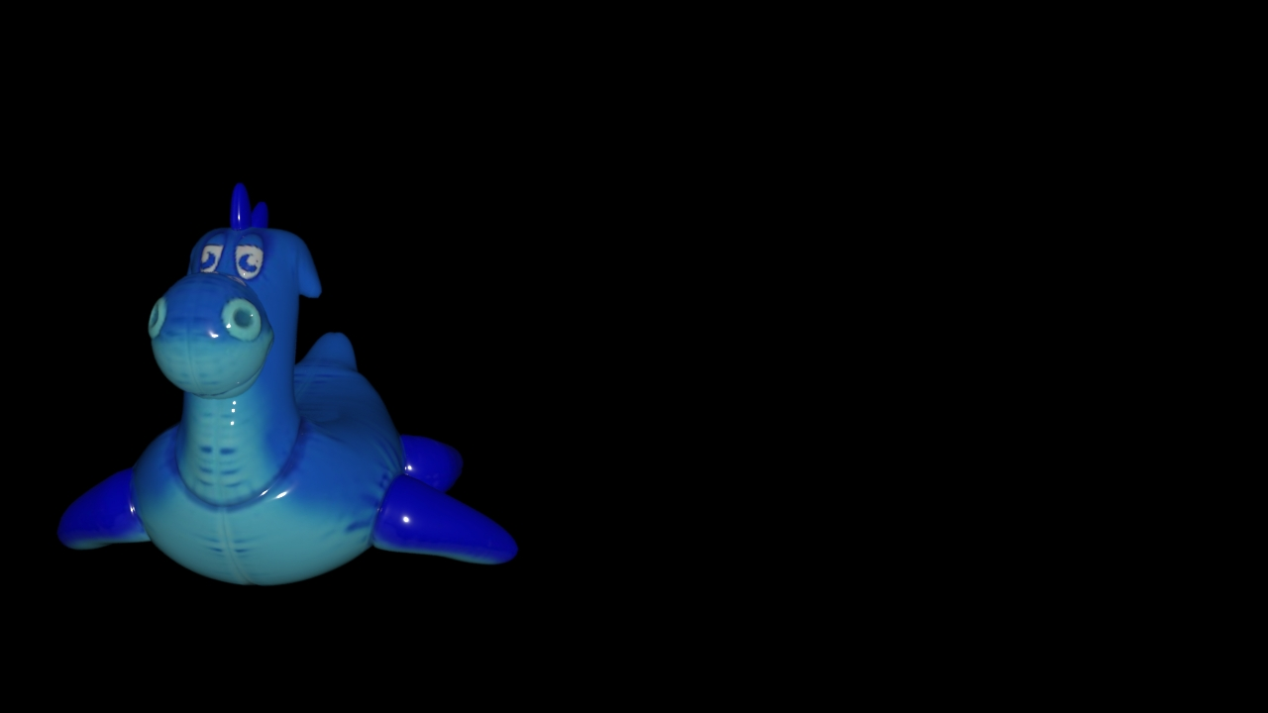
Multi-Segment Motion Blur
Small Arrays

Slide 4
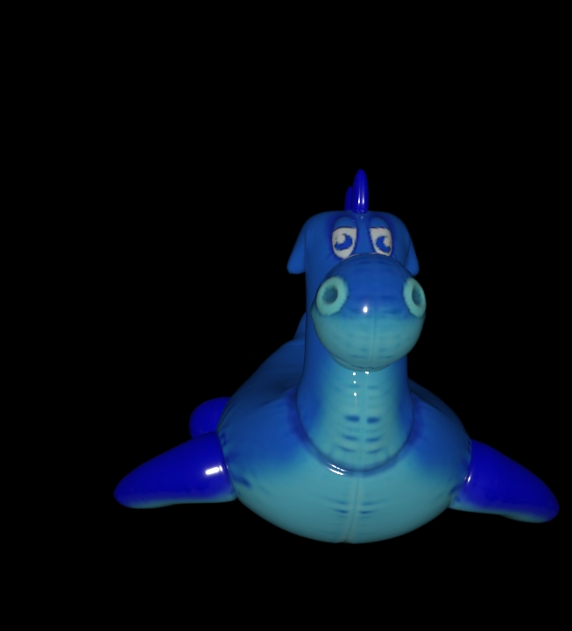
Multi-Segment Motion Blur
Small Arrays

Slide 5
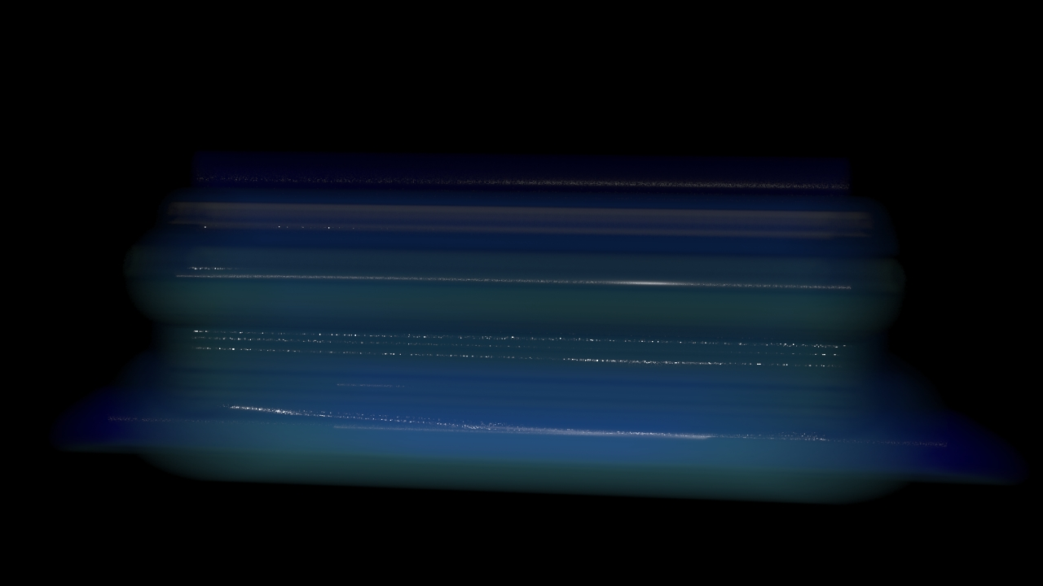
Multi-Segment Motion Blur
Small Arrays

Slide 6
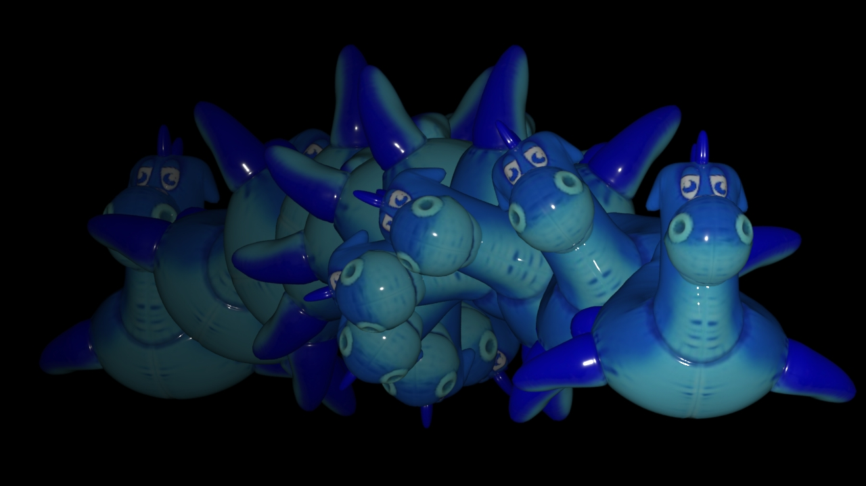
Multi-Segment Motion Blur
Small Arrays

Slide 7
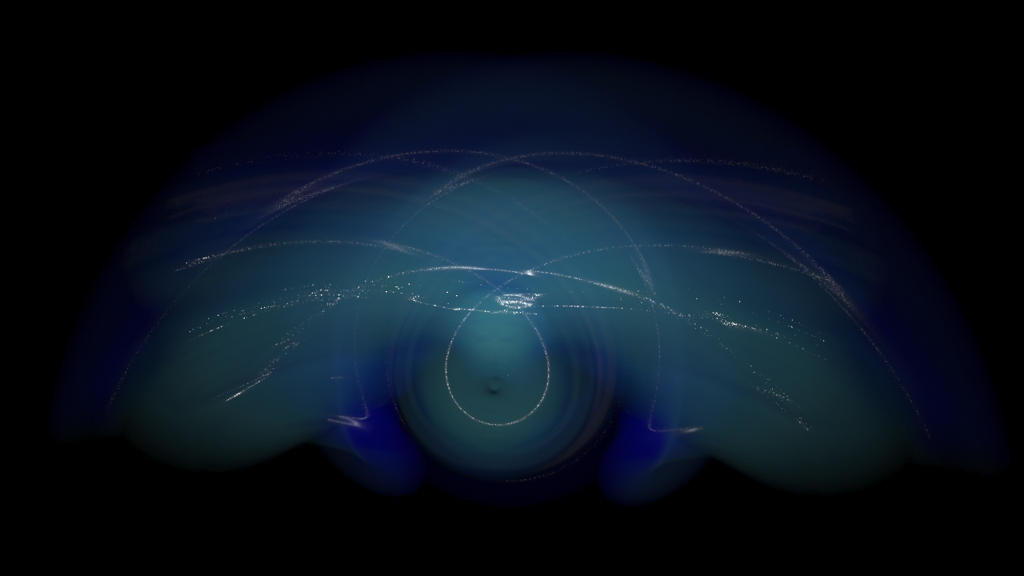
Multi-Segment Motion Blur
Small Arrays

Slide 8
Multi-Segment Motion Blur
Small Arrays
static constexpr int MAX_SEGMENTS = 32;
int
computeTransforms(Mat44 xforms[MAX_SEGMENTS])
{
double time[MAX_SEGMENTS];
size_t nsegs = fillMotionTimes(times);
for (size_t i = 0; i < nsegs; ++i)
xforms[i] = computeTransform(time[i]);
return nsegs; }
void
fillMotionTimes(double times[MAX_SEGMENTS])
{
assert(_nsegments <= MAX_SEGMENTS);
for (size_t i = 0; i < _nsegments; ++i)
times[i] = computeSegmentTime(i, _nsegments));
return _nsegments; }
Fixed Arrays

Slide 9
Multi-Segment Motion Blur
Small Arrays
void
computeTransforms(std::vector<Mat44> &xforms)
{
std::vector<double> times;
fillMotionTimes(times);
xforms.reserve(times.size());
for (auto tm : times)
xforms.push_back(computeTransform(tm)); }
void
fillMotionTimes(std::vector<double> &times)
{
times.reserve(_nsegments);
for (size_t i = 0; i < _nsegments; ++i)
times.push_back(computeSegmentTime(i, _nsegments)); }
Dynamic Arrays

Slide 10
Multi-Segment Motion Blur
Small Arrays
void
computeTransforms(std::vector<Mat44> &xforms)
{
std::vector<double> times;
fillMotionTimes(times);
xforms.reserve(times.size());
for (auto tm : times)
xforms.push_back(computeTransform(tm)); }
void
fillMotionTimes(std::vector<double> &times)
{
times.reserve(_nsegments);
for (size_t i = 0; i < _nsegments; ++i)
times.push_back(computeSegmentTime(i, _nsegments)); }
Dynamic Arrays

Slide 11
Godbolt - Fixed array
Small Arrays
test():
push rbp
mov rbp, rsp
mov DWORD PTR [rbp-4], 0
.L3:
cmp DWORD PTR [rbp-4], 2
jg .L4
cvtsi2sd xmm0, DWORD PTR [rbp-4]
mov eax, DWORD PTR [rbp-4]
cdqe
movsd QWORD PTR [rbp-96+rax*8], xmm0
add DWORD PTR [rbp-4], 1
jmp .L3
.L4:
nop
pop rbp
ret
void test()
{
#if 0
std::vector<double> times;
times.reserve(10);
#else
double times[10];
#endif
for (int i = 0; i < 3; ++i)
times[i] = i;
}

Slide 12
Godbolt - std::vector
Small Arrays
test():
push rbp
mov rbp, rsp
push rbx
sub rsp, 40
lea rax, [rbp-48]
mov rdi, rax
call std::vector<double, std::allocator<double> >::vector() [object constructor]
lea rax, [rbp-48]
mov esi, 10
mov rdi, rax
call std::vector<double, std::allocator<double> >::reserve(unsigned long)
mov DWORD PTR [rbp-20], 0
.L6:
cmp DWORD PTR [rbp-20], 2
jg .L5
mov eax, DWORD PTR [rbp-20]
movsx rdx, eax
lea rax, [rbp-48]
mov rsi, rdx
mov rdi, rax
call std::vector<double, std::allocator<double> >::operator[](unsigned long)
cvtsi2sd xmm0, DWORD PTR [rbp-20]
movsd QWORD PTR [rax], xmm0
add DWORD PTR [rbp-20], 1
jmp .L6
.L5:
lea rax, [rbp-48]
mov rdi, rax
call std::vector<double, std::allocator<double> >::~vector() [object destructor]
jmp .L9
mov rbx, rax
lea rax, [rbp-48]
mov rdi, rax
call std::vector<double, std::allocator<double> >::~vector() [object destructor]
mov rax, rbx
mov rdi, rax
call _Unwind_Resume
.L9:
add rsp, 40
pop rbx
pop rbp
ret
void test()
{
#if 1
std::vector<double> times;
times.reserve(10);
#else
double times[10];
#endif
for (int i = 0; i < 3; ++i)
times[i] = i;
}

Slide 13
Godbolt - std::vector
Small Arrays
test():
push rbp
mov rbp, rsp
push rbx
sub rsp, 40
lea rax, [rbp-48]
mov rdi, rax
call std::vector<double, std::allocator<double> >::vector() [object constructor]
lea rax, [rbp-48]
mov esi, 10
mov rdi, rax
call std::vector<double, std::allocator<double> >::reserve(unsigned long)
mov DWORD PTR [rbp-20], 0
.L6:
cmp DWORD PTR [rbp-20], 2
jg .L5
mov eax, DWORD PTR [rbp-20]
movsx rdx, eax
lea rax, [rbp-48]
mov rsi, rdx
mov rdi, rax
call std::vector<double, std::allocator<double> >::operator[](unsigned long)
cvtsi2sd xmm0, DWORD PTR [rbp-20]
movsd QWORD PTR [rax], xmm0
add DWORD PTR [rbp-20], 1
jmp .L6
.L5:
lea rax, [rbp-48]
mov rdi, rax
call std::vector<double, std::allocator<double> >::~vector() [object destructor]
jmp .L9
mov rbx, rax
lea rax, [rbp-48]
mov rdi, rax
call std::vector<double, std::allocator<double> >::~vector() [object destructor]
mov rax, rbx
mov rdi, rax
call _Unwind_Resume
.L9:
add rsp, 40
pop rbx
pop rbp
ret
void test()
{
#if 1
std::vector<double> times;
times.reserve(10);
#else
double times[10];
#endif
for (int i = 0; i < 3; ++i)
times[i] = i;
}

Slide 14
Houdini - Custom array class
Small Arrays
template <typename T>
class array {
T *_begin = nullptr;
T *_end = nullptr
T *_capacity = nullptr;
public:
~array() { delete [] _begin; }
size_t size() const { return _end - _begin; }
size_t capacity() const { return _capacity - _begin; }
void push_back(const T &item) {
if (capacity() == size())
reserve(capacity()+BSIZE);
*_end++ = item;
}
void reserve(size_t sz) {
if (capacity() >= sz) return;
T *tmp = new T[sz];
std::copy(_begin, _end, tmp);
delete [] _begin;
_end = tmp + size();
_capacity = tmp + sz;
_begin = tmp;
}
};
Houdini Array Class
Typical implementation of a dynamic array.

Slide 15
Houdini - Custom array class
Small Arrays
template <typename T, size_t STACKSIZE=8>
class small_array : public array<T> {
T _buffer[STACKSIZE];
public:
small_array()
{
_begin = _buffer;
_end = _buffer;
_capacity = _buffer + STACKSIZE;
}
};
Houdini Small Array
Typical implementation of a dynamic array.

Slide 16
Houdini - Custom array class
Small Arrays
template <typename T>
class array {
T *_begin = nullptr;
T *_end = nullptr
T *_capacity = nullptr;
public:
~array() { delete [] _begin; }
size_t size() const { return _end - _begin; }
size_t capacity() const { return _capacity - _begin; }
void push_back(const T &item) {
if (capacity() == size())
reserve(capacity()+BSIZE);
*_end++ = item;
}
void reserve(size_t sz) {
if (capacity() >= sz) return;
T *tmp = new T[sz];
std::copy(_begin, _end, tmp);
delete [] _begin;
_end = tmp + size();
_capacity = tmp + sz;
_begin = tmp;
}
};
Delete non-heap memory!

Slide 17
Houdini - Custom array class
Small Arrays
Approaches
std::string
SSO
LLVM
separate class

Slide 18
Houdini - Custom array class
Small Arrays
class Foo
{
void *_begin;
void *_end;
void *_capacity; };
class Bar : public Foo
{
int _buffer[10]; };
sizeof(Foo)
= 3 * sizeof(void *)
= 24 bytes
sizeof(Bar)
= sizeof(Foo) + 10 * sizeof(int)
= 24 + 40
= 64 bytes
Inheritance

Slide 19
Houdini - Custom array class
Small Arrays
class Foo
{
void *_begin;
void *_end;
void *_capacity; };
class Bar : public Foo
{
int _buffer[10]; };
sizeof(Foo)
= 3 * sizeof(void *)
= 24 bytes
sizeof(Bar)
= sizeof(Foo) + 10 * sizeof(int)
= 24 + 40
= 64 bytes
void *_begin;
void *_end;
void *_capacity;
Inheritance
void *_begin;
void *_end;
void *_capacity;
int _buffer[10];

Slide 20
Houdini - Custom array class
Small Arrays
template <typename T>
class array {
T *_begin = nullptr;
T *_end = nullptr
T *_capacity = nullptr;
public:
~array() {
if (isHeap())
delete [] _begin;
}
size_t size() const { return _end - _begin; }
size_t capacity() const { return _capacity - _begin; }
void push_back(const T &item) {
if (capacity() == size())
reserve(capacity()+BSIZE);
*_end++ = item;
}
void reserve(size_t sz) {
if (capacity() >= sz) return;
T *tmp = new T[sz];
std::copy(_begin, _end, tmp);
if (isHeap())
delete [] _begin;
_end = tmp + size();
_capacity = tmp + sz;
_begin = tmp;
}
bool isHeap() const
{
return _begin != (T *)((char *)this)+sizeof(*this));
}
};
Houdini Array Class
Typical implementation of a dynamic array.

Slide 21
Houdini - Array Usage
Small Arrays
void
computeTransforms(array<Mat44> &xforms)
{
array<double> times;
fillMotionTimes(times);
xforms.reserve(times.size());
for (auto tm : times)
xforms.push_back(computeTransform(tm)); }
void
fillMotionTimes(array<double> &times)
{
times.reserve(_nsegments);
for (size_t i = 0; i < _nsegments; ++i)
times.push_back(computeSegmentTime(i, _nsegments)); }
Function API
Functions all take base array class

Slide 22
Houdini - Array Usage
Small Arrays
void
computeTransforms(array<Mat44> &xforms)
{
small_array<double> times;
fillMotionTimes(times);
xforms.reserve(times.size());
for (auto tm : times)
xforms.push_back(computeTransform(tm)); }
void
fillMotionTimes(array<double> &times)
{
times.reserve(_nsegments);
for (size_t i = 0; i < _nsegments; ++i)
times.push_back(computeSegmentTime(i, _nsegments)); }
Function API
Functions all take base array class

